Slide 1


SLK Software
We are turning the financial world right side up…
Notes:
Picture:
https://unsplash.com/photos/XLm6-fPwK5Q

Slide 2

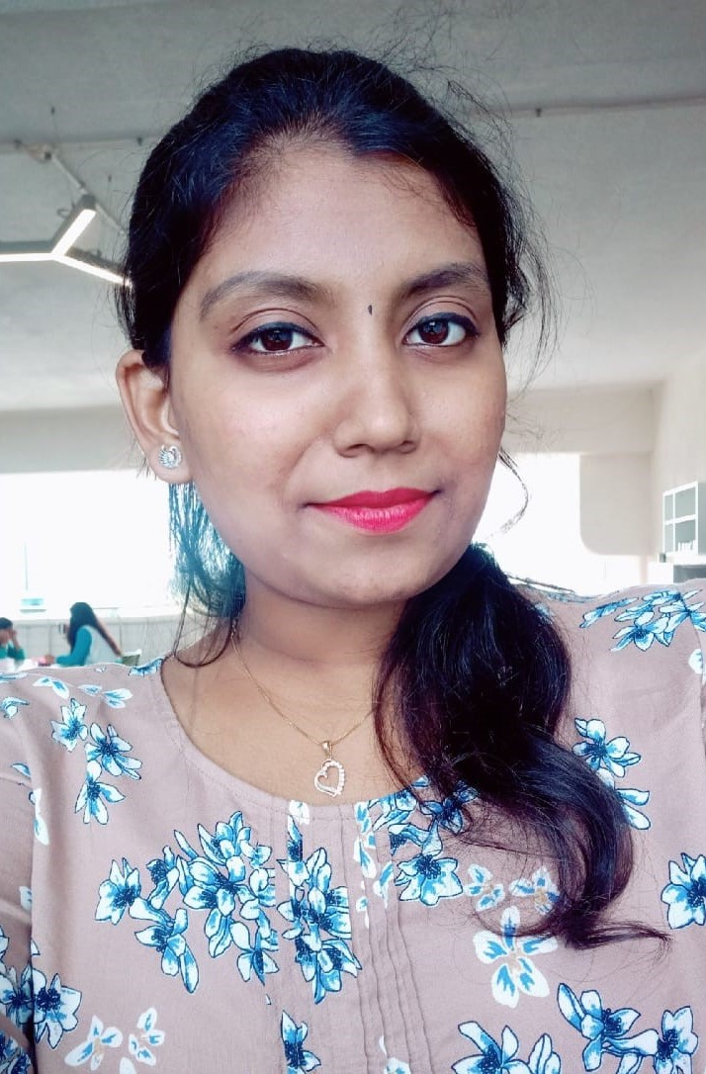
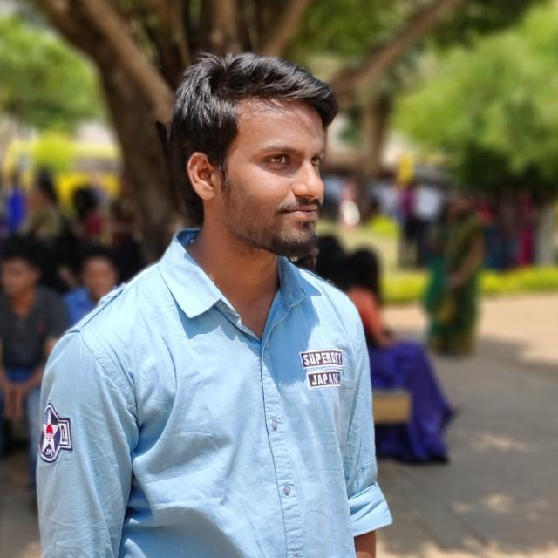
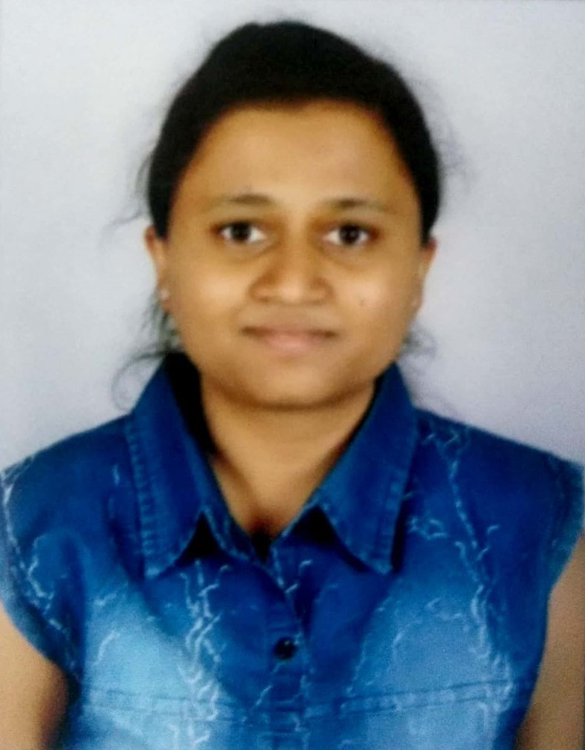
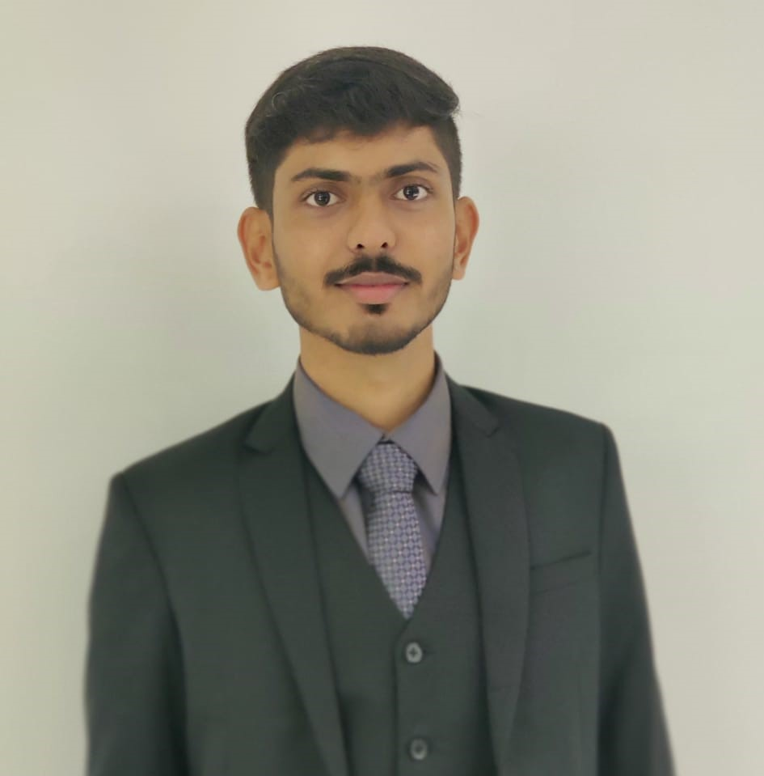
UPASANA
OUR TRAINER
Nayana SU
109357
Suhil Mulla
Komal Valagadde
109333
109334
Shashank Thakur
Shashank S P
109336
109353
Notes:
Picture:
- https://unsplash.com/photos/VW8MUbHyxCU

Slide 3


WHERE DO WE STAND…??
Earlier
Present
Basic Theoretical and less practical knowledge.
OOPs basics.
Practical knowledge in Java .
Angular7
Spring Boot
DBMS
HTML, CSS, Bootstrap
J2EE,JSP
Agile Methodology, JUnit, GitHub, Maven, Tomcat, Jenkins
Notes:
Picture:
https://unsplash.com/photos/QBpZGqEMsKg

Slide 4

Data model and DB applications
Core Java programming
Exceptions
Collections
HTML,CSS
OOPS Concept
Database concepts
MySQL
Data Structures
WEEK-1
WEEK-2
WEEK-3
WEEK-4
Framework for 8 weeks
WEEK-8
WEEK-7
WEEK-6
WEEK-5
JDBC and Web Design fundamentals
Bootstrap
Agile Methodology
JUnit
GitHub,Maven
Tomcat,Jenkins
Project Completion
Spring REST
(Core & MVC)
myBatis
Framework of Angular
Javascript
Angular JS
JEE Architecture
Notes:
Picture:
- https://unsplash.com/photos/fkaZiACUb5w

Slide 5
Objectives
Long term Objective:
To become a Full Stack Developer by gaining the skills required to work with Front End and Back End Web technologies required for the application.
Short term Objective:
To design an online shopping application where in we can search for different products, add and remove from the cart.

Slide 6
Features
Login
Logout
View products by categories
Add item to the cart
Login as admin
Edit product details using admin account
Add products of different categories to the cart
Remove items from the cart

Slide 7

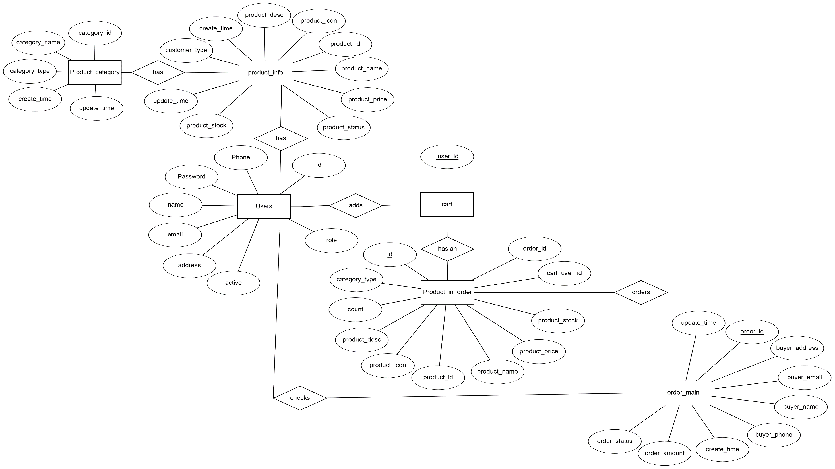
E-R Diagram
Notes:
Picture:
- https://unsplash.com/photos/1vwwZ-BmmrE

Slide 8











Tools Used
FrontEnd
BackEnd
Devops & Data
Title Here
Title Here
Notes:
Picture:
- https://unsplash.com/photos/y0_vFxOHayg

Slide 9

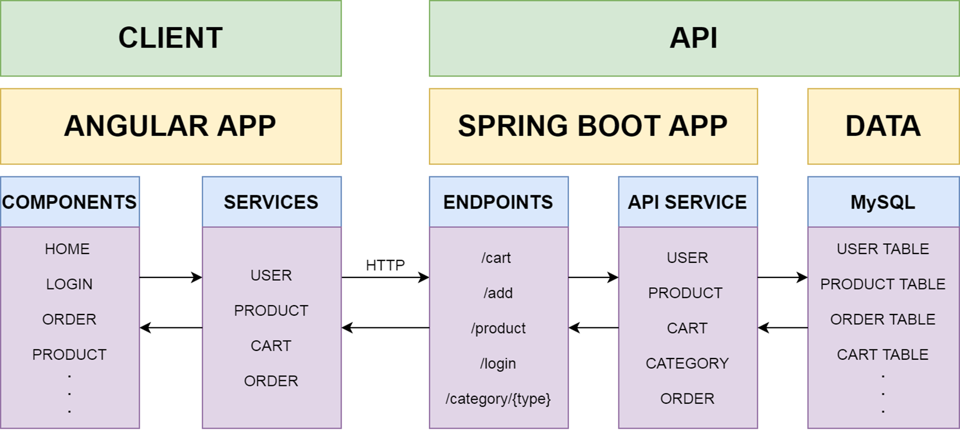
Structure of the Project
Notes:
Picture:
- https://unsplash.com/photos/IXHNBGTKJfw

